Slide 1
ATU H&S Preliminary Induction

Slide 2
Overview
Where to find Safety Information
First Aid & Defibrillators
Accident & Incident Reporting
Fire & Emergency Procedures
Fire Prevention
Disabled Persons
Refuge Point
Covid-19
General Safety Tips
Housekeeping.
Aim
The aim of this induction is to provide students/ visitors with information on Health & Safety including emergency procedures, accident, incident and near misses and Covid-19

Slide 3
Campus Overview

Slide 4
Where to find Safety Information?
Head of School & Head of Department
Student Guide ATU-Student-Guide-2023-24-WEB-AW.pdf
ATU Intranet – Health & Safety - H&S
Notes:
Insert link to H&S website for specific campus

Slide 5
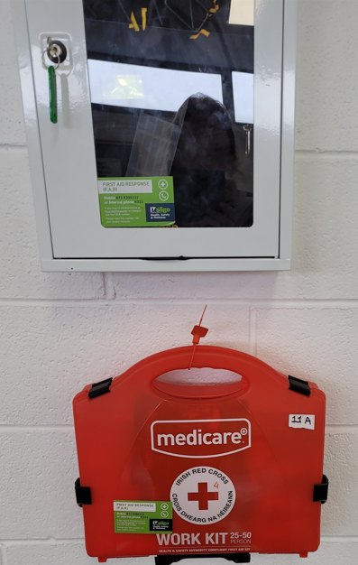
First Aid & Defibrillators
First Aid and Defibrillators are available on each campus.​
First aid boxes are located strategically throughout the campus. Please familarise yourself with the location of your nearest first aid box and defibrillator
EMERGENCY SERVICES Dial 999 or 112
ATU Sligo First Aid Responders 071 7155333 or 5333
Inform the first aider where the victim is located; give the building closest room number and floor you are on. The First Aider will then proceed to the location.
Notes:
A Minor Medical Incident is classified as ​
​a faint, a minor cut or abrasion, ​
a minor burn etc i.e. ​
an injury that can be treated on Campus by one of the First Aid Responders on 071 9315333 or 5333
A Major Medical Incident is classified as an accident or incident that requires the attendance of an Ambulance i.e.​
a major bleeds,​
a broken limb, a fall, ​
an electric shock, ​
where a person is unresponsive​
a person has chest pain, has difficulty breathing, is choking etc

Slide 6
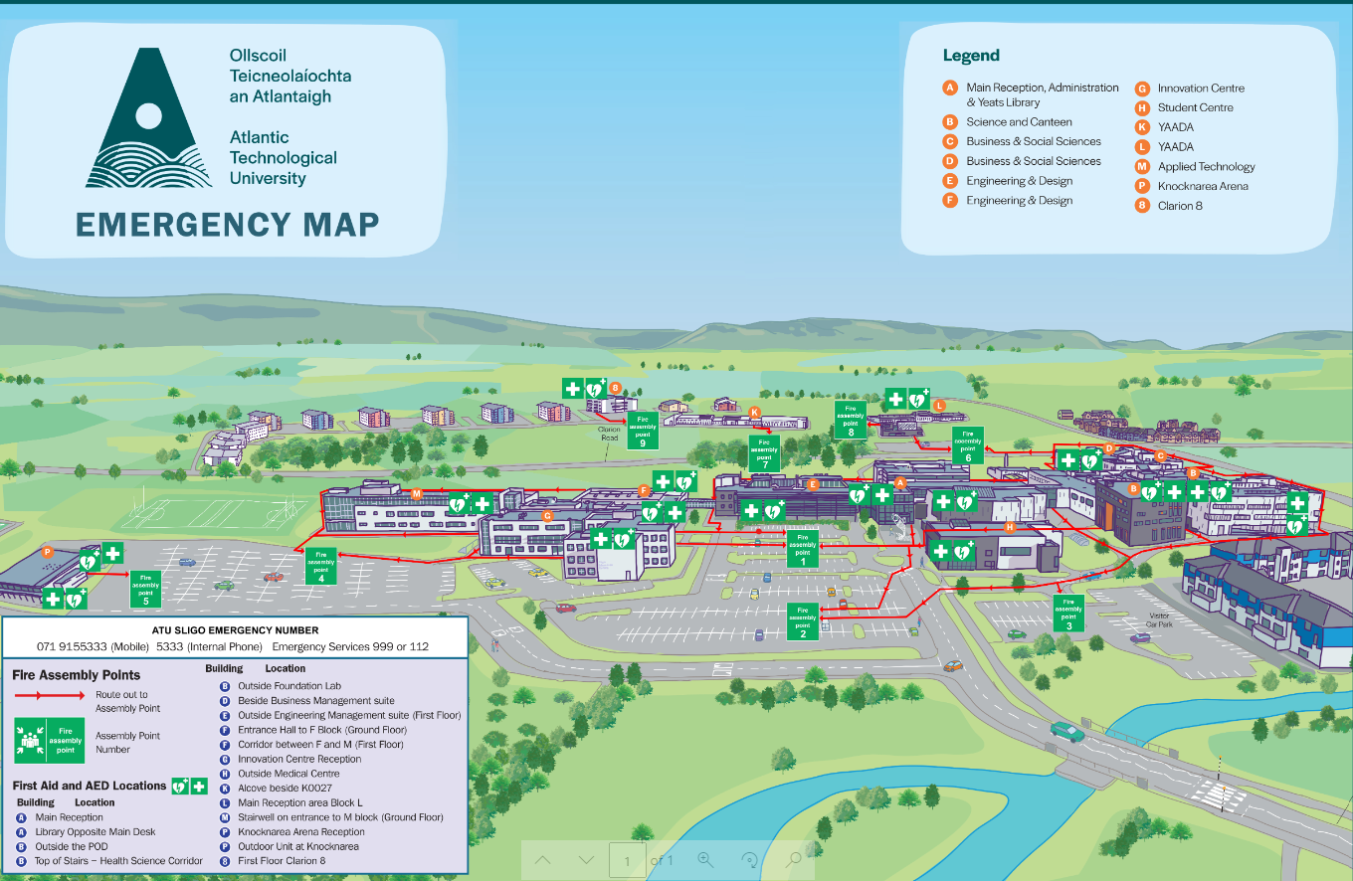
Notes:
On the emergency map display on the screen shows the locations of all first aid and defibrillators across ATU Sligo campus

Slide 7
Accident/Incident reporting
Report all accidents, incidents and near misses that occur on the college campuses, regardless of severity to your head of school or a member of staff immediately.
This also applies to any hazardous situations that you become aware of please notify a member of staff immediately and your Head of Department.
Incident Report Forms are available from staff members and by contacting healthandsafety@atu.ie

Slide 8
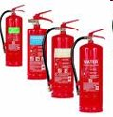
Fire & Emergency Procedures
Action on discovering a fire:​
Raise the alarm – using, red break glass unit. ​
On hearing the continuous fire alarm all building users must:​
Ensure the safe shutdown of equipment/electricity/gas in use​
Evacuate the building by the nearest exit route​
Proceed to the assembly point​
Do not collect personal belongings​
Do not use the lift​
Do not re-enter the building until the “all-clear” has been given​
Please do not use fire extinguishers unless trained in their use.​

Slide 9
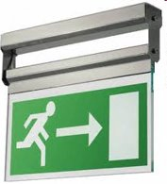
Fire & Emergency Procedures
Emergency Exits
Familiarize yourself with emergency exits ​
Leave by nearest exit​
Emergency exits are on maps throughout the college.
Fire Assembly Points
All students should make there way to the nearest Fire Assembly Point in the event of an emergency evacuation or drill. ​
Fire Assembly Points are in various designated points in the car park/ grounds of ATU campuses.
Fire Drills
Regular Fire and Emergency Evacuation Drills will take place during term. These procedures will simulate real emergency procedures.
All students/ Visitors must participate fully in the drills obeying staff instructions and leaving the building

Slide 10
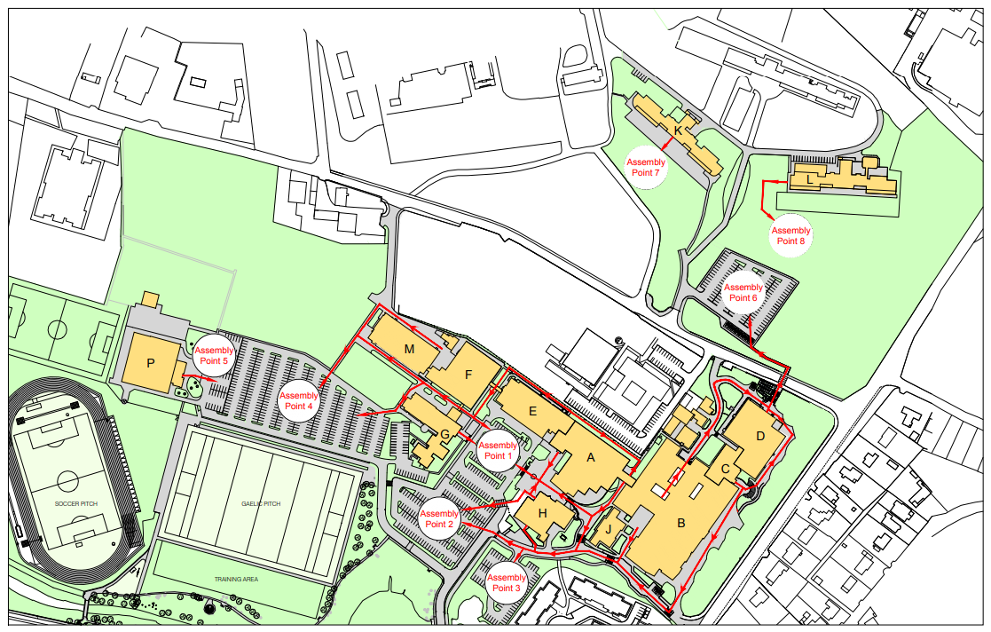
Fire & Emergency Procedures
Evacuation Plans
Notes:
Evacuation plan are posted on the back of all doors, the plan will oultline the quickest route to exit the building from your current location. And what assembly point to go to.

Slide 11
Fire Prevention
Students have an important role to play in preventing the outbreak and spread of fire as follows:
Place all litter in bins provided
Schoolbags must never be stored in corridors or lobbies. Place all schoolbags in lockers provided
Smoking/ Vaping which includes e – cigarettes is not permitted in any part of the building or grounds other than in the designated smoking areas.
Always follow laboratory rules when operating equipment including gas, sparks, or naked flames.
Food and drinks only to be consumed in designated dinning areas.
Fire doors should never be wedged or propped open.
Never park in front of any exits or blocking routes for emergency services to gain access to the campus.

Slide 12
Disabled Persons
Disabled Persons should contact the Disability Officer Located in the Curve to complete a Personal Emergency Evacuation Plan (PEEP)
The PEEP will provide a disabled persons with an individual plan on how to evacuate buildings safely in the event of an emergency.
Disabled persons assisted to refuges in stairwells if on upper floors
Notify Fire Wardens of their exact location they will then arrange for evacuation from the building.

Slide 13
Refuge Point
An area of refuge is a place in a building designed to hold occupants during a fire or other emergency when evacuation may not be safe or possible.
Ensure at least one other person stays with the person in the refuge area and that you notify a warden or staff member of their exact location.
The fire brigade will be notified of the location.
Never attempt to carry someone down the stairs, all concerned are at risk of being injured.

Slide 14
Covid-19
Please adhere to all National guidance and Public Health advice in relation to COVID – 19. Public Health Advice
Students/ Visitors must adhere to all COVID -19 measures that have been put in place on campus.
Students must also adhere to and follow all COVID -19 control measures outlined by ATU staff. If in doubt, contact your head of department/ ATI contact person for clarification on COVID -19 requirements for your dept or school
In order to continue to suppress virus spread we all have a personal responsibility to take measures in order to protect ourselves and others.
Notes:
Add in link to HSE and individual CRPs

Slide 15
Housekeeping
Good Housekeeping is the first and most important level of preventing falls due to slips and trips.​
Keep your area tidy. (clean up spills, remove trailing leads, filing etc.)​
​Report damage or obstruction to your lecturer.
All access/egress routes must be kept clear at all times of objects/items that may impede access or egress (trailing leads).​ Do not obstruct exits points and stairwells

Slide 16
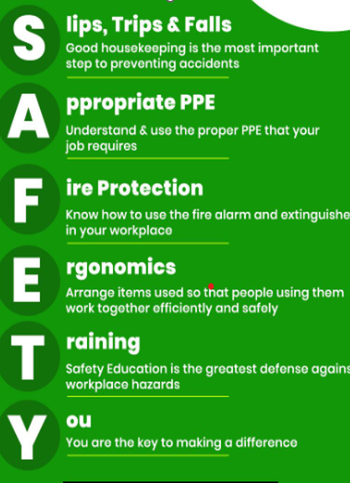
General Safety Tips
Never eat, drink, or smoke while using hazardous chemicals​
Always read labels’ SDSs 9Safety Data Sheets) prior to use​. Store all hazardous chemicals properly​ as per manufacturer’s instruction
Use personal protective equipment as required​
Make sure all chemical containers are properly labeled​
Always wash up after using chemicals ​
In the event of a chemical spill contact the department’s Chemical Spill Response Team ​
Never smell or taste a chemical to identify it​
Always use hazardous chemicals as intended
Never use equipment unless supervised and trained to do so.
Please do not endanger yourself or others.
Know all emergency procedures and equipment​ and familiarize yourself with the nearest ER exit

Slide 17
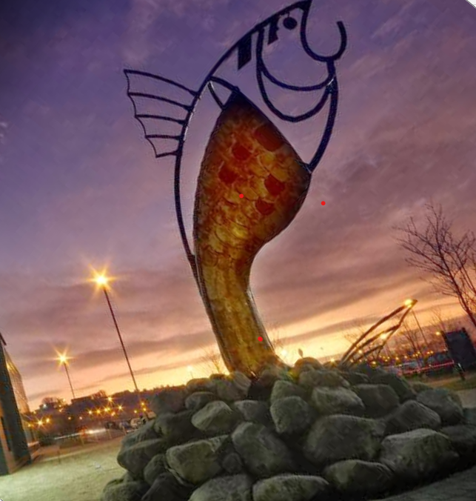
Thank you!

Slide 18
I agree that I understood the information set out in the ATU Sligo Health and Safety Staff Induction . I understand that if I have any questions about any information contain within the presentation that , I will raise them with my Manager .
Declaration of Understanding

